Slide 1

INTERNATIONAL SKILLS PARTNERSHIPS
SKILLS FOR EMPLOYABILITY:
BRINGING THE LEARNING HOME

Slide 2
OBJECTIVES OF THE PARTNERSHIP
Improve course design and innovative teaching methodology
Lecturer development and exchange
Employer engagement and developing a curriculum in Automotive
Raise the perception of vocational skills through a skills competition
Develop a quality lecturer self-assessment process
Raise the profile of entrepreneurship and vocational skills in general with employers and young people

Slide 3
PARTNERS
ORBIT COLLEGE
HARROW COLLEGE
UK PROJECT LEAD
TEACHER TRAINING
SOFT SKILLS
DUDLEY COLLEGE
QUALITY ASSURANCE
BELFAST METROPILITAN
COLLEGE
SKILLS COMPETITION
AUTOMOTIVE TRAINING
BRITISH COUNCIL SPONSOR

Slide 4

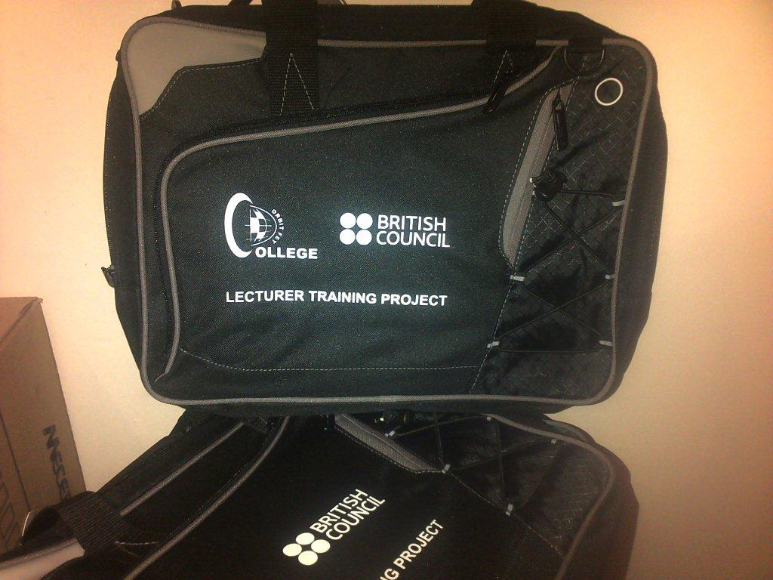
HARROW-ORBIT
DELIVERABLES
Teacher Training
Soft Skills

Slide 5
LECTURER TRAINING
Expectations | Training Schedule | Target | What have we covered so far | End Product
To be able to interact effectively with students | Induction was conducted on 5 March 2014 | Fifty (50) Report 191 Lecturers for Phase 1 | Induction & Orientation | PoEs will be compiled and assessed
To improve facilitation skills Improve results and student retention | Training started on the 7th March | From all Departments and from our three Campus (Mankwe, Rustenburg and Brits) | Facilitation methods Interactive lessons | Certificate of attendance will be awarded
Improve on administration of PoEs and PoAs | Duration: 8 weeks (Fridays 8:00-11:00) |  | Excellent curriculum Leaders Enterprise Passport

Slide 6


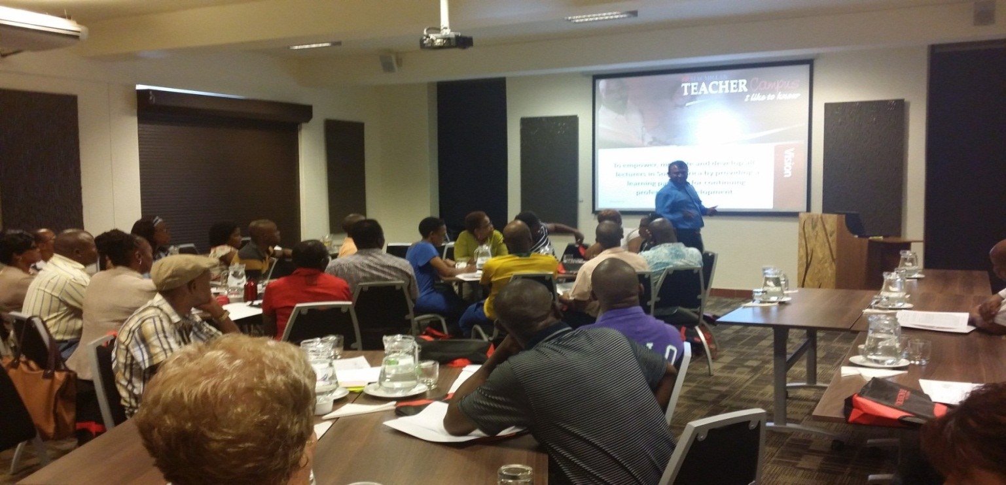


CHAMPAGNE MOMENTS
HARROW-ORBIT DELIVERABLES
– TEACHER TRAINING
Lecturer training on Vocational Education in the global economy commenced on 5 March 2014 at all campuses. In view of creating synergy between Heads of Divisions, Senior Lecturers and lecturers it was decided that Heads of Divisions will be the facilitators. To date fifty (50) Report 191 lecturers have successfully participated in the pilot programme.

Slide 7
……LECTURER TRAINING (CONT).
Topics covered included among others:
Effective orientation and induction of students
Developing an excellent learning programme
Being an excellent teacher
Linking the student experience with the work environment
Assessing competencies
Making the most of learning resources
Encouraging the teacher as a learner
Monitoring quality and planning improvement

Slide 8

SOFT SKILLS
ENTERPRISE PASSPORT
A tool designed to help develop capacity for enterprise, innovation and initiative
  Enterprise Qualities & Attitudes
  Enterprising Behaviour
  Enterprising Knowledge & Understanding
  Enterprising Skills

Slide 9
WHY THE PASSPORT?
Provides students with:
Students become more:
A chance to practice skills required for employment
Real evidence/examples
  to use on a CV
  application form
  and something positive to show a potential employer at interviews
Enterprising
Pro-active
Motivated
Empowered
Self-confident
Focussed
Able to set objectives
Aware of the skills required for employment
Motivated overall and showed these skills in their general studies

Slide 10
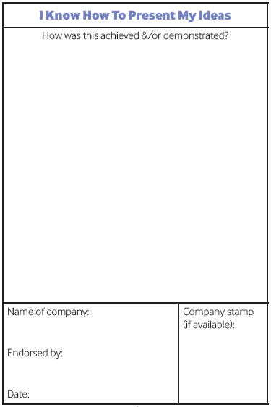
ENTERPRISE PASSPORT CONT…
ADVANTAGES
The Enterprise Passport will act as a permanent record of enterprise skills and attributes
Once it has been completed it can support progress to further studies or into employment

Slide 11


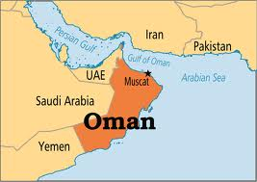




Current use of Enterprise Passport

Slide 12


AND NOW ALSO IN….

Slide 13
ACTIVITIES INVOLVED
The Passport has been given to Lecturers that are participating in the Lecturing Training as well as Level 4 Students to be used during their Work-based Experience

Slide 14

DUDLEY-ORBIT
DELIVERABLES
Quality of teaching and learning
Mentoring
All Heads of Divisions and Senior Lecturers were trained as observers, quality assurers and mentors for lecturers. The training was delivered by Harrow College and Dudley College.

Slide 15
MENTORING PROGRAMME
The training received resulted in the development of a mentoring and coaching programme by ORBIT College which included the following templates:
Mentoring template A- Monitoring and evaluation planning matrix.doc for
Novice qualified lecturers
Existing lecturers with identified needs
Skilled lecturers from the industry

Slide 16
IMPLEMENTATION
Class visits were conducted by Heads of Divisions after which six (6) lecturers (two (2) per campus – one (1) NC(V) and one (1) Report 191, were identified to participate in the pilot programme
Apart from observations made by HODs during class visits, lecturers were also given an opportunity to do their own assessments

Slide 17
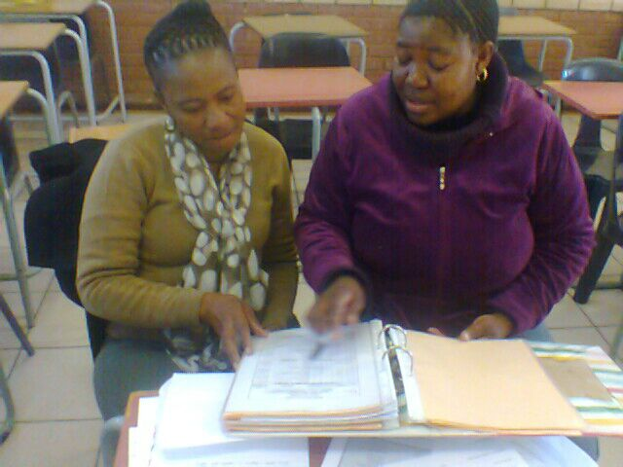
CHAMPAGNE MOMENTS
DUDLEY COLLEGE
A one-on-one support process by an experienced lecturer

Slide 18
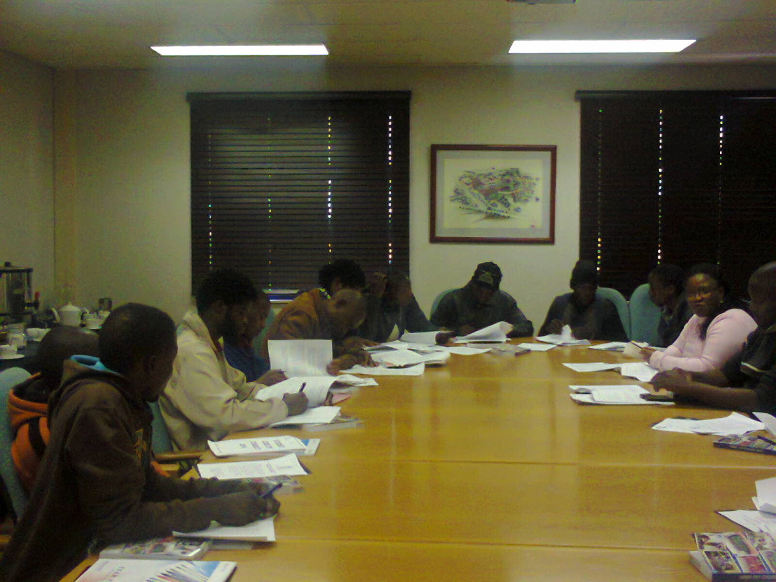
QUALITY OF TEACHING AND LEARNING
Self-assessment tools were developed as part of the mentoring and coaching programme and were implemented. These tools allow for true and continuous self-assessment and introspection in addressing the challenges identified in the process.

Slide 19
CHAMPAGNE MOMENTS
ORBIT COLLEGE MOMENTS
SUCCESSFULLY REGISTERED A SKILLS PROGRAMME
TO TRAIN BACKYARD MECHANICS

Slide 20
TRAINING FOR
BACKYARD MECHANICS
Target:
20 Mechanics from Mabele Podi, Mogwase and Ledig
Recruitment Process :
Consultation with Moses Kotane Councillors, Traditional Leaders, Community Liaison Officers and Local Mechanics.
Funder:
ORBIT TVET College, Ford Motor Corporation SA and National Skills Fund
Commencement:
19 May 2014

Slide 21
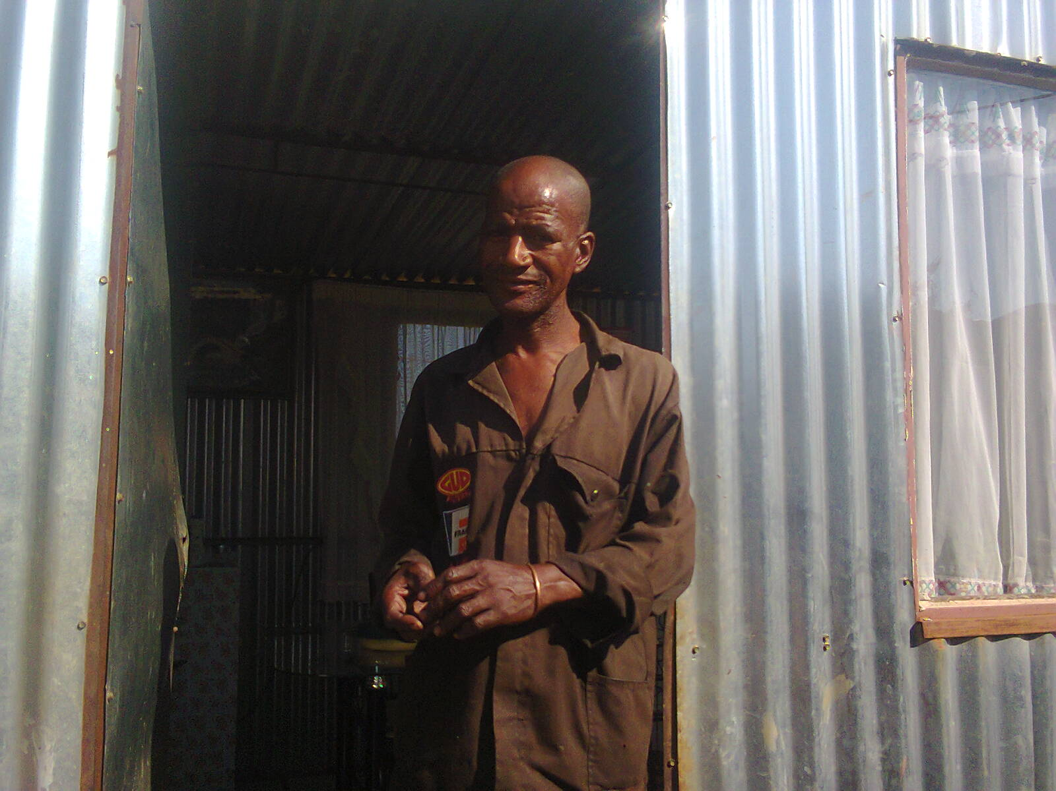
OUR BENEFICIARIES
Bushy Namane: He has no formal qualification
Has been running his business from his yard in Ledig for 15 years
He learned the skill from his late father.
Has created employment for 2 workshop assistants
This training will opened so many doors for me, thank you very much for this opportunity!

Slide 22
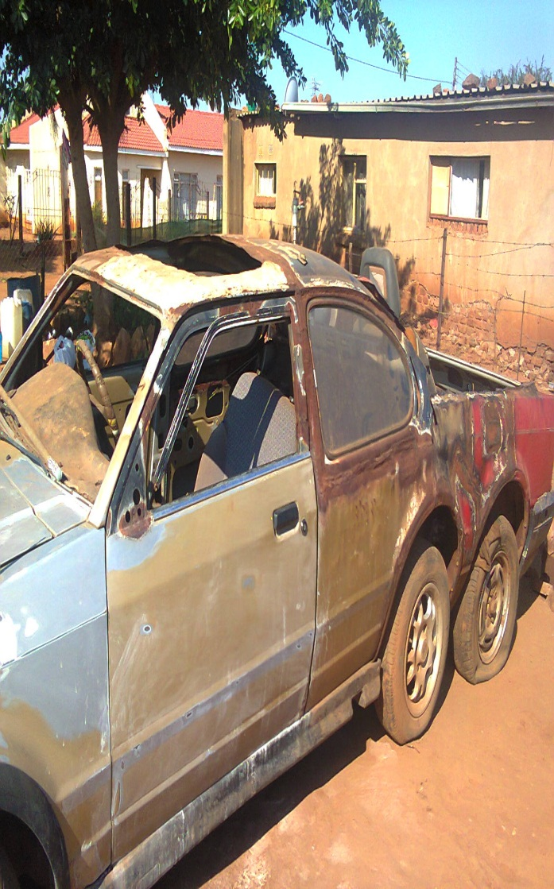
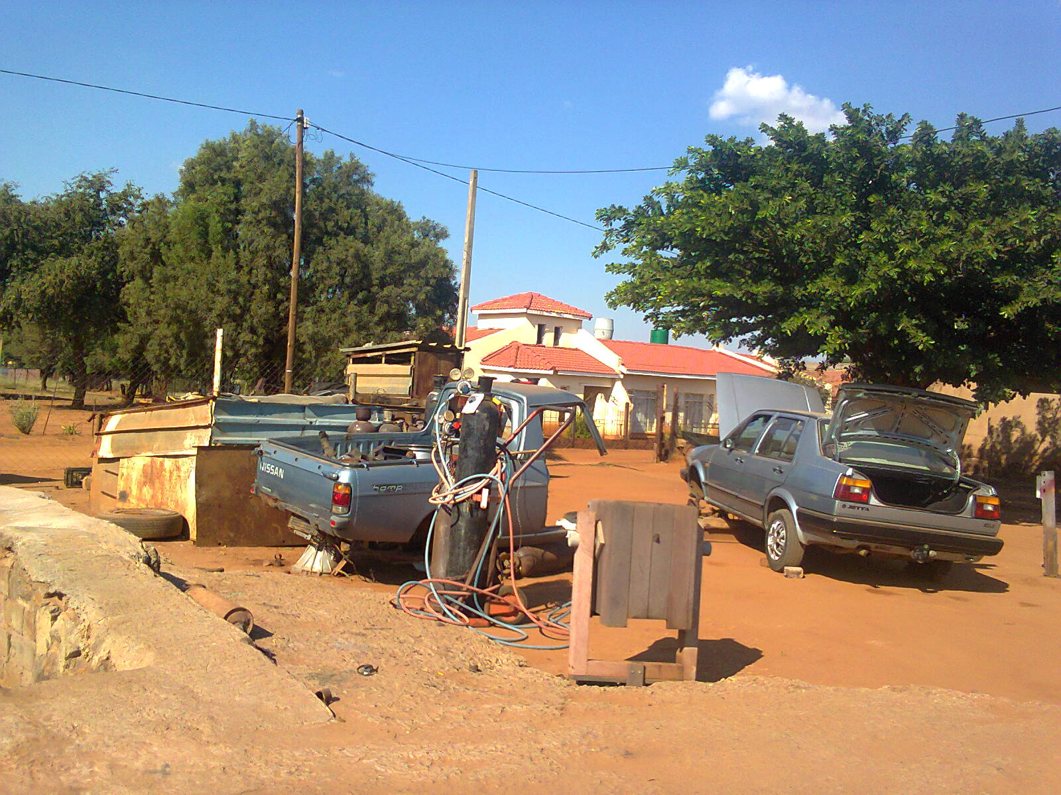
MODIFYING, SPRAY PAINTING AND DIESEL
AND PETROL ENGINES

Slide 23
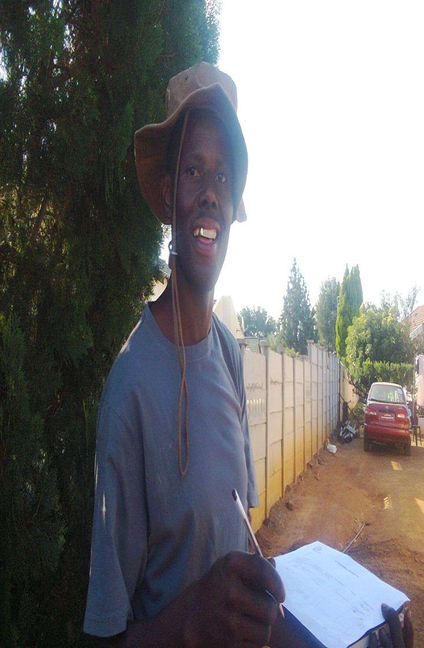
OUR BENEFICIARIES
Oupa Rakoo
Has been operating his business from home for 8 years
Specialises in both Petrol and Diesel Engines
If you believe….. Dreams do come true! Who would have thought that The British Council and ORBIT will give me this opportunity!!

Slide 24
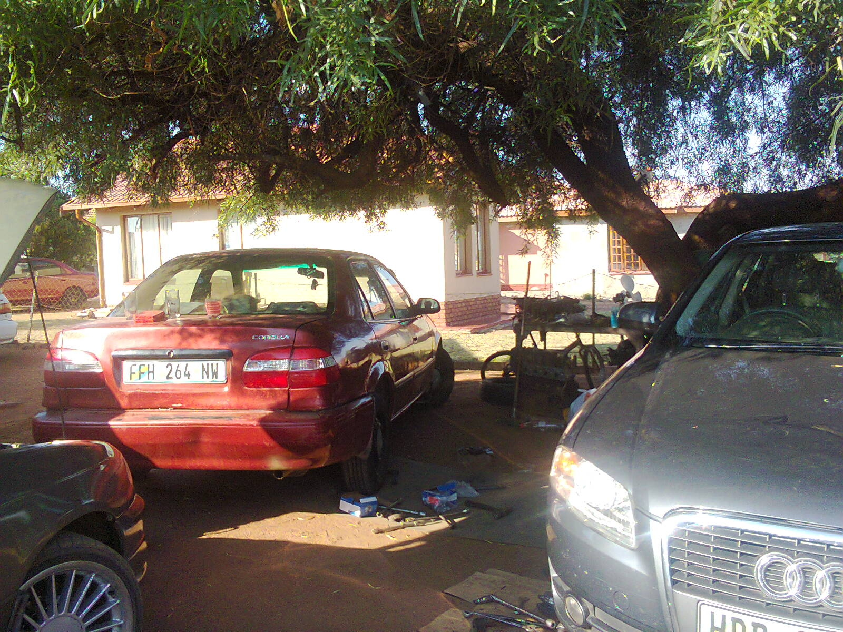
THE WORKSHOP

Slide 25
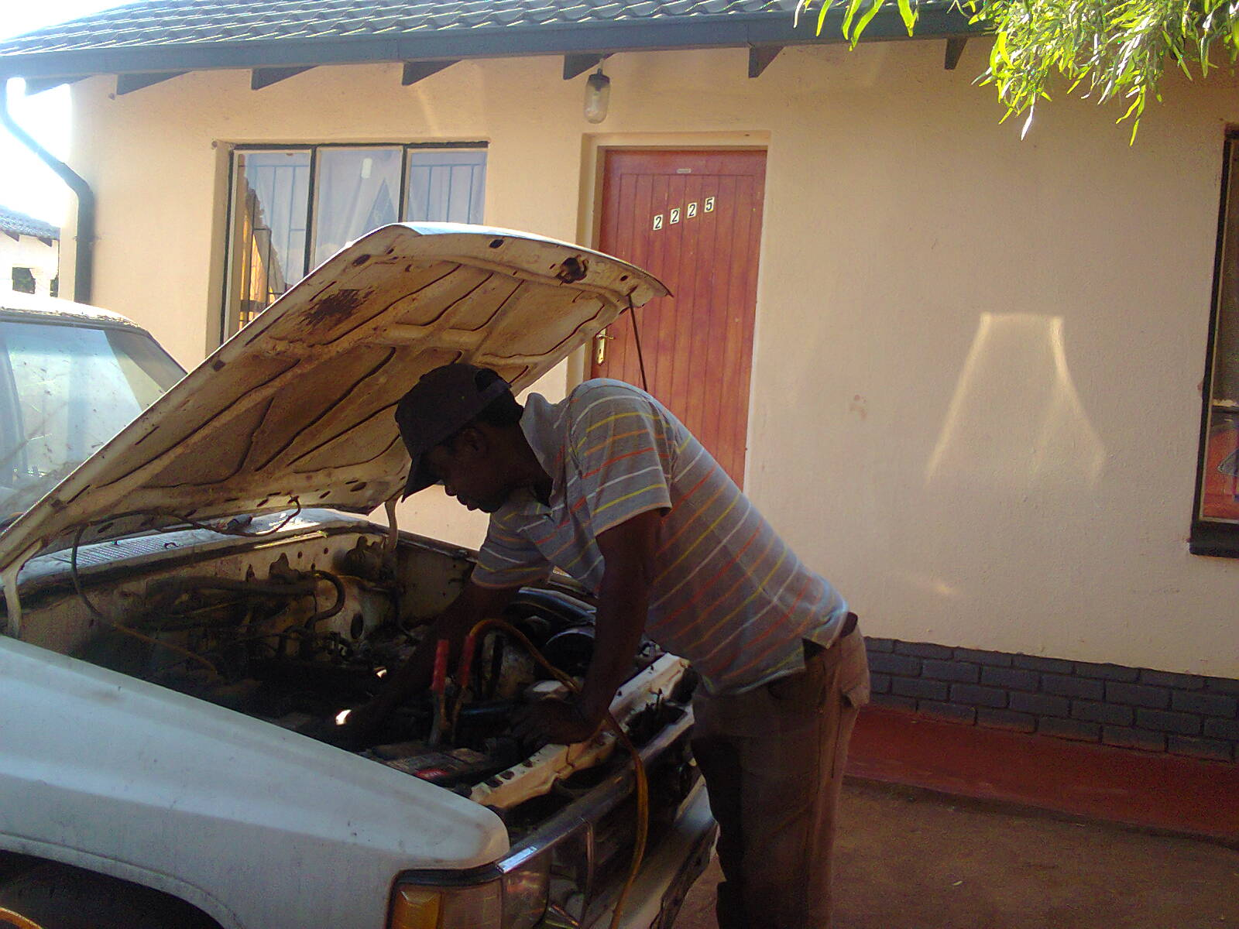
OUPA AT WORK

Slide 26
WORLD SKILLS COMPETITION
The World Skills Competition is an international skills competition for youth that is held in different countries every two years.
Competitors are aged between 17 - 22 years old and they are required to demonstrate their excellence in a number of different skilled trades and technology areas.
The competition is promoted and managed by WorldSkills International, formerly known as the International Vocation Training Organisation (IVTO).

Slide 27
…WORLD SKILLS CONTINUED
Areas of focus for the Competition:
Construction
Electrical installation,
Motor Vehicle
Creative Arts and Fashion
Building Technology
Information and Communication Technology

Slide 28
…… WORLD SKILLS CONTINUED
The objectives of the competition are to:
Promote the exchange between young professionals from various regions of the world;
Exchange of skills, experience and technological innovations;
Raise the understanding in governments, education and industry to the importance of skills training.
Raise the awareness of youth and those who influence youth to the opportunities available in skilled professions.

Slide 29

WE WISH WE COULD SAY:
“SEE YOU IN SAO PAULO IN 2015!!”

Slide 30

HOWEVER…..
ORBIT College has taken the initiative to host a Skills Competition on 2 October 2014. Although the primary focus of the project is Automotive, the College has decided to incorporate other fields namely Engineering Related Design and Electrical Infrastructure. In responding to the Minister's call for "the Decade of the Artisan", ORBIT College decided to incorporate the vision into the competition.
The Skills Competition aims to address the continuous energy crisis challenges experienced in our communities and will enhance creativity in coming up with innovative ideas to address the challenges. The competition will create a platform for our students to showcase their skills and expertise and to interact with the various stakeholders.
NB: Industry experts will serve as adjudicators during the competition.
The competition wIill be fully funded by ORBIT College as an annual event

Slide 31
What contributed to the success of the project partnership
The Project had clear outcomes and deliverables
Deliverables were developed jointly by all involved
Based on national priorities
Monthly Evaluation and monitoring by the SA Britis
Impact has been collected and disseminated in Tunisia and the UK and now in South Africa
We did not see this as a stand-alone project but integrated it into the normal business of the College (e.g. Assessments are written
every Friday to enable lecturers to attend training)
Support by the Senior Management of the Colleges
Support by DHET and the British Council

Slide 32

Benefits derived
INCREASED INTERNATIONAL AND NATIONAL LINKS
The partnership, funded by the British Council, has broadened our scope of interactions with Industry due to best practices at our partner colleges in the UK
We have been able to link and forge working relationships with the following:
VATMETCO
MAVESA PLATINUM MINES
BAKGATLA BA KGAFELA TRIBAL AUTHORITY
MOSES KOTANE LOCAL MUNICIPALITY
THE TRANSPORT EDUCATION AND TRAINING AUTHORITY (TETA)
MERSETA
FOUR TOPS ENGINEERING SERVICES CC.
RUSTENBURG LOCAL MUNICIPALITY

Slide 33
PARTNERING WITH
FORD SA
Through our interaction and collaboration with FORD,ORBIT has received the following donation to assist us with effectively facilitating our Automotive classes

Slide 34
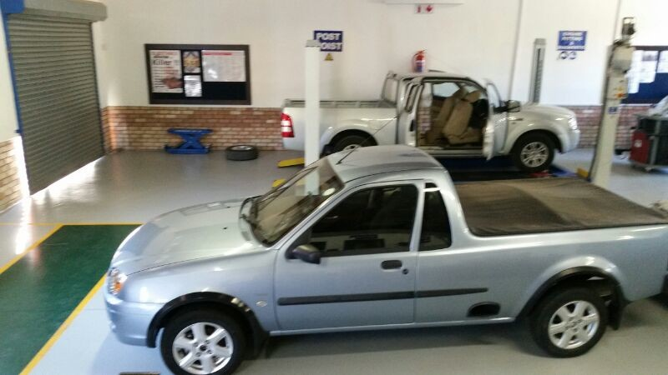
Some of the vehicles donated by FORD

Slide 35
BENEFITS DERIVED …
Implementation of the lessons learnt to enhance interaction with partners mentioned and those that will join in the programmes moving foward.
We have also developed a policy on mentoring and coaching (still to be ratified by Council)

Slide 36

BENEFITS DERIVED
Raising of College Profile
Increased Intake In Engineering Report 191
Improved Student Attendance
Improved Pass Rate (Tests & Exams)
Increased Outreach Target
Positive Attitude Of ‘Can Do’ Has Been Instilled And Adopted By Lecturers
Renewed Attitude Of Need For Development Has Been Noticed Amongst Lecturers
Increased awareness of importance of Quality Assurance of learning delivery.
Stronger and a meaningful co-operation with sister colleges.

Slide 37
FLAT BEER MOMENTS
The Lecturer training has been limited only to the Report 191 lecturers for the pilot phase due to limited Resources and time constraints.
We had to reduce the target number of beneficiaries for the Motor Mechanic programme due to limited funds and resources.
Limited engagement with Belfast Metropolitan College as one of the partners due to unforeseen circumstances
Technical challenges related to compatibility of IT systems for VLE (Virtual Learning Environments) process has hampered interaction and sharing best practices between international and local partners.

Slide 38

OUTCOMES NOT YET ACHIEVED
Some of the implementation will happen after the project has ended (Skills competition – October 2014 and Phase 2 of Lecturer Training - August 2014)
Not able to participate in the World Skills Competition in 2015 (Baby steps first)
Reduced the number for Backyard Mechanics from 20 to 10 beneficiaries due to funding
Reduced the number of trainees for Lecturer Training due to limited resources and time constraints
However, continued engagement and creative problem solving mechanisms are put in place to address the challenges.

Slide 39
DISSEMINATION
Hosted on the 14 July 2014
  Attended by over 200 delegates including:
  Business and Industry
  Six colleges
  Queen Mother – Royal Bafokeng Tribal Authority
  Participants: Lecturers and the Mechanics
Purpose:
  Showcase activities the college is involved in.
  Give exposure to all stakeholders involved.
  Allow for join-in of other interested potential partners.
  Networking and discussion opportunity.

Slide 40
Conclusion
Through this project we were and will be able to:
Play a critical role in producing students that will fit into the global world
Share best practices also at an international level.
Myself as the Academic Manager and the Project Team experienced enhanced teaching and learning by:
Building confidence in staff and thus improved students attendance
Developing a sense of ownership of the teaching and learning process in lecturers
Sparking a passion for the work done by lecturers which contributed to improved learner performance

Slide 41
Conclusion
Individual growth due to this project.
Has helped expand understanding; from NC(V) & Report 191 and suddenly to Occupational programmes
Has given greater understanding of the challenges experienced by lecturers, therefore allowing for informed intervention
Ensured growth of all staff involved in different functions; lecturers as students and HODs who were conducting the training
Where to now?
Need to expand co-operation among colleges in SA to ensure that all colleges grow and benefit from the lessons learnt.

Slide 42
CONCLUSION
Due to the unique situation in South Africa with our own dynamics, one can not blindly apply everything that works in another country in our own country.
However, this partnership with the UK Colleges yet again affirmed that it is necessary to expand your horizons and to learn from Best Practice. You cannot be complacent but have to be open to learning and be prepared to change
John F Kennedy once said: Leadership and learning are indispensable to each other! This project definitely inspired me as a leader and motivated me once again to fulfil my role as strategic leader to pursue the vision, mission and goals of ORBIT College!
I am therefore committed to ensure that our learning in the UK results in value added leadership and academic excellence in ORBIT College, the South African TVET sector and more specifically in the North West Province and therefore invite all stakeholders to engage with us in pursuit of quality teaching and learning.

Slide 43
CONCLUSION
“Change will not come if we wait for some other person or some other time. We are the ones we’ve been waiting for. We are the change that we seek”
Barack Obama

Slide 44


Conclusion

