Slide 1
To develop a bridging programme which would be offered to entry level students at the beginning of the academic year, to bridge the gap between school exit level and entry to colleges e.g. Accelerate and Advance (AaA). To develop a Learning Company Model in conjunction with Walsall College, which will enable the implementation of EMC’s vision of work integrated learning exposure leading to improve employment opportunities.
Objectives of the Partnership
EMC and Walsall College
British Council Skills for Employability Partnership

Slide 2
Phase 1 - Designed, planned and prepared a school to college entry bridging programme which includes: - Mathematics - English - Computer and digital literacy - Vocational tasters (right programme, right placement) - Employability
The bridging programme (AaA)
Initial 3 weeks
On programme - to link skills development to career progression

Slide 3
Phase 2 - Piloted the concept of the AaA programme for on course intervention with existing students to demonstrate the impact on success rates. E.g. Mathematics
The bridging programme (AaA)
Level | 2013 (Pass rate %) T1 | 2014 (Pass rate %) T1 | Variance
2 | 64% | 71% | 7%
3 | 77% | 80% | 3%
4 | 79% | 89% | 10%

Slide 4
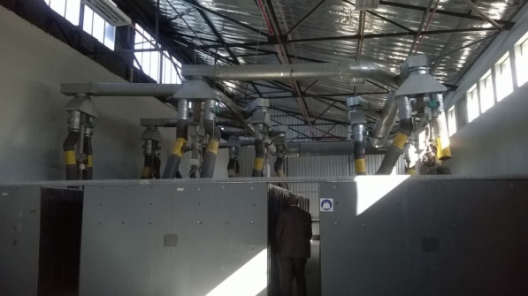
To prepare students with employability skills that are tested and improved in a real work based environment e.g. production, sports, welding, IT, hospitality etc. To ensure students are skilled, professional and able to demonstrate employer led core competencies and transferable skills within their industry e.g. developing the core competencies required to complete the job through to higher level, transferable skills e.g. quality assurance, entrepreneurialship, leadership
The Learning Company Model

Slide 5
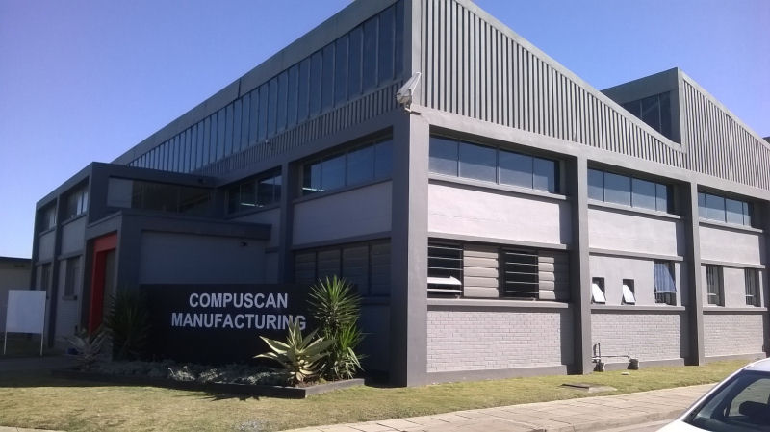
EMC has secured industry links to support the development of the learning company model Employer led programmes training students with the skills required to meet industry recruitment needs: - Volkswagen - Compuscan - Transnet
The Learning Company Model

Slide 6
Walsall College will secure the accreditation and certification of an Ofqual regulated awarding body - Accredited Skills for Industry (asfi) for the AaA and Employability programme The Employability Programme will be contexualised to the South African market and delivered and assessed through the learning companies Secure funding for the programmes to be delivered at EMC and other South African Colleges through the AoCSA
Sustainability beyond the project

Slide 7
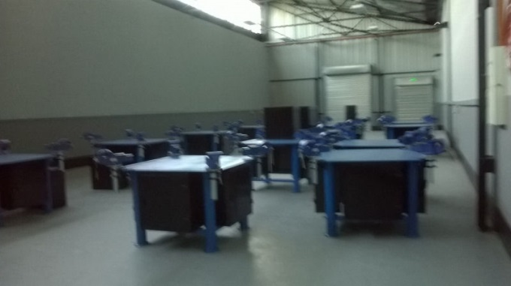
Walsall College and EMC aim to develop a joint Virtual College, the classroom without boundaries To improve student engagement and achievement through global industry standard learning technologies To inspire and develop innovative and employer / student centric teaching practices that revolutionises education in South Africa and UK
3 Year Vision

Slide 8
Be a part of our journey to the classroom without borders Signature and approval……. Sign here!
3 Year Vision

