Slide 1
Closing Thoughts
Reflections and implications for policy, systemic change and partnerships
…in the context of the continuous change towards improvement in the sector…

Slide 2
The Policy Environment
White Paper:…..the purpose of the TVET colleges is to prepare students for the workplace of self employment through systems and partnerships
Skills Accord: Commitment 2 (Placements in Industry) and 8 (Improved Performance of Colleges)
Streamlining of College Programmes with mixed models of delivery
College Stability at all levels, from Management structures to Financial Systems
We need to see change and transition (albeit slow) as well long term support and persistence, with continuous need for change and development
How do we use partnerships and international links to inform Curriculum reform
How do we disseminate Best Practice and Sharing

Slide 3
System Reflections
Recognise we have a dynamic / changing / new Post-Schooling System
Resourcing Change for the System vs Colleges taking Responsibility for Change
Curriculum Transformation; Career Pathways;
  who is driving change
  some can be changed some cannot
Staffing and Remuneration issues
Building integrated systems in our colleges
Professionalising our College Sector

Slide 4
Reflections on the Skills for Employability Project
The success of the project to date has been echoed by everyone today
The International Skills Partnership (ISP) Model looks very valuable; how do you operationalize and expand this, with the expansion of partners who are not colleges
How effectively are you using the leverage of the bilateral relationship between our two countries to engage employers
A Thought:
How much have the UK colleges gained out of the partnership
Can our SA colleges share anything about working with diversity

Slide 5
China
The similarities between China and South Africa, vocational education which involves improving mechanisms to develop skills training with improved quality
It seems that government positively and actively supports long term improvement of the College Sector with adequate resources
Build confidence in our own system

Slide 6
The conditions need to be right
The partnership needs to be:
Special - to make the extra effort worthwhile
Time-limited - with clear boundaries and controls
Active - genuinely building on the skills and resources of the partners
Measurable - with the goals and results clearly established
Problem-centred - with genuine issues to work on and find solutions to

Slide 7
Challenges in Partnership
Different systems
No dedicated responsible person
Not part of college development strategy
No clear goals

Slide 8
Business Perspective Ford
A partnership is a personal relationship built on trust, mutual respect and genuineness from both parties to make it work. Both must want something from this relationship.
Both contribute resources to the partnership
Agree to the details around training levels and outputs, the facility and equipment requirements, number of learners that could be accommodated, actual mode of training delivery, training duration, assessment
Agreed on the roles and responsibilities of the two parties.
Look to the long term benefits
How do we expand this this nationally to other colleges
Can you create a industry forum on college partnerships and college improvement

Slide 9
Merseta
Critical role of contributing towards sustainable funding
Focused on quality development and dynamic curricula changes
Qualifications to scale up the capacity of lecturers
Brokering relationships with industry
Emphasised the need to careful planning based on local need
How do your expand this to other SETAs
How do you engage with DHET structures, especially with curriculum pathways

Slide 10
Colleges Reflections on the Partnerships
Extensive / Wide scope
Expanded Projects – bigger than initially designed
Improving existing programmes or processes
Employability Focus
Innovation Expansion into new areas
Communication across partnerships

Slide 11
Reflections on Partnerships
Are complicated but have a thread of structure in content
Need careful defining in detail
Programme scope creep is normal, expect it and deal with it
Need contingency funding
Usually our Time Frames are to short
Partnerships are two-way but industry involvement makes it 3-way
Communication between partners
Need Project Management at all level
Integrating partnerships in all the college with ‘outward looking staff and students’
Do partnerships rest in one central place (unit) in a college or are they the responsibility of all college ‘people’
Challenge: Where there is no industry – a mindset change

Slide 12
A thought on partnerships from Ghana and Nigeria
The responsibility to make the partnerships profitable and successful, rests with both parties - relationship and self drive

Slide 13
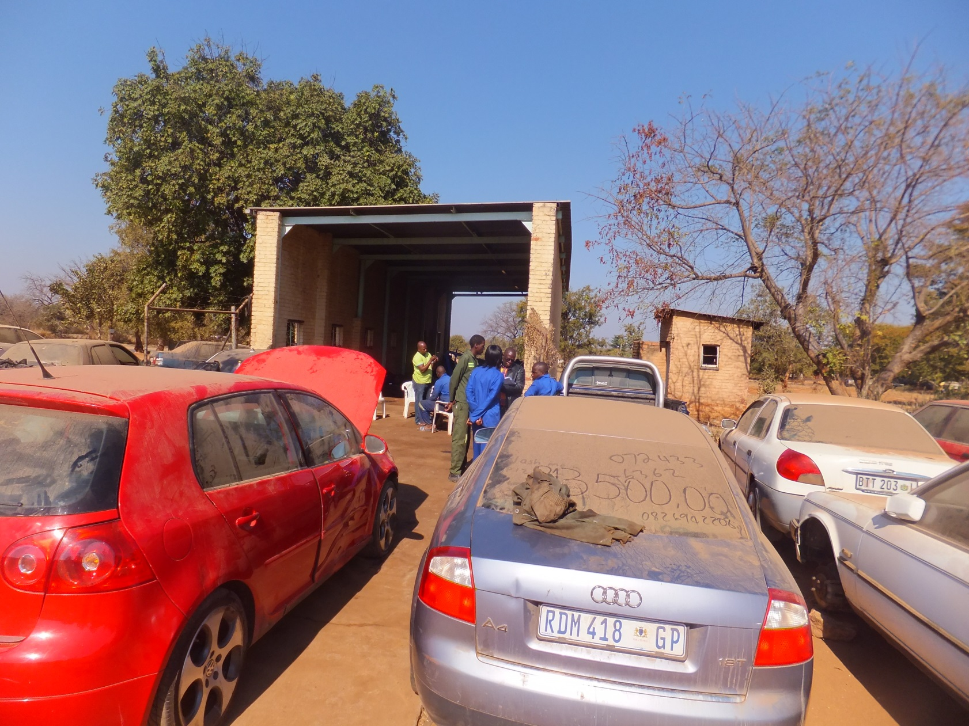
Is this a workplace

Slide 14
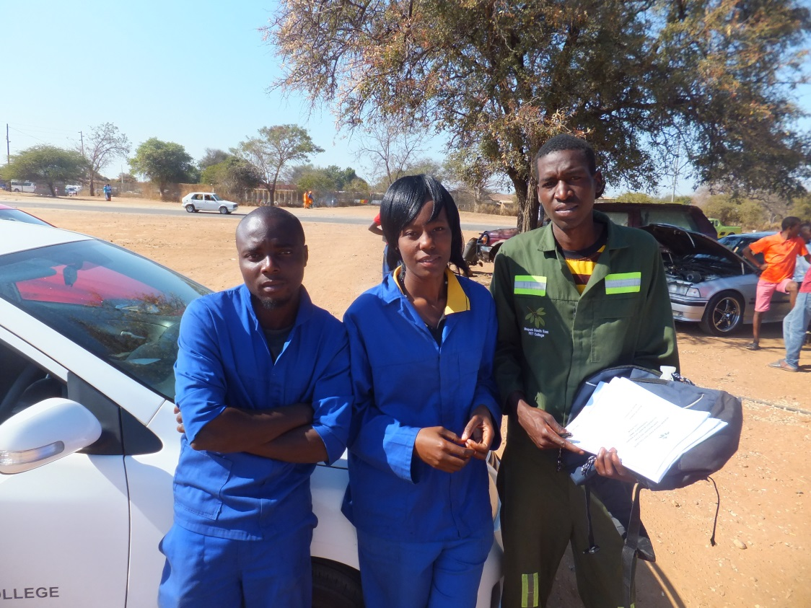
Lekau: on the weekends I work in my neighbours backyard

Slide 15
So what do you need to do to take this forward

Slide 16
National Level Thoughts
Need DHET engagement on curriculum, remuneration, planning
SETA engagement with other sectors
Industry forums
A national college engagement / national college forums / conferences
Other national learning forums / best practice forums

Slide 17
Skills for Employability Looking Forward
Looking forward to look at strengthening existing partnerships and using them to develop new partnerships
How are you measuring impact and disseminating best practice
How do you ensure impact that is sustainable and on-going, using other funding as well as from college funding
I suggest it calls for on-going very strong PROJECT MANAGEMENT
Partnership and Project over time – one year is too short – systemic change takes time
How do we expand and share Best Practice and Lessons Learnt into other sectors or colleges

Slide 18
College Level Thoughts
Catalytic change in colleges that is managed and driven
Build INTEGRATED systems and processes down to campus Level
Management and Leadership involvement
Invest in quality development of Project Management with administrative resources
Managing the diversity of workplaces in our local communities
Create Professionalism in our College Spaces
Building Livelihoods into all our curricula and pedagogy thinking
Increasing motivation and responsibility of lecturers and students
Challenge:
How does this integrate with Grant Funded Pipeline programmes / Scale Up
Where do these Partnerships fit into the College Strategic Planning

Slide 19
Colleges Next Steps
Partnership take time, change your mindsets
How are you going to sustain what you have started
College funding for shared sustainability
Transform your college organisational culture
Build this into strategic planning
Electronic learning platforms

Slide 20
Thank you

