Slide 1
LEAP into Learning: Inclusive, quality language learning and teaching through digital innovation
UN Transforming Education Summit Solutions Day, 17 September 2022
Department of Basic Education South Africa, UNICEF & British Council (UK)

Slide 2
Session plan
Introduction of panel and purpose of session
Learn English Audio Programme (LEAP) within the South African educational context
LEAP concept
Video demonstration of LEAP and a young teacher’s experience of using LEAP
Linking LEAP to Thematic Action Track 4: Digital learning and transformation
Scaling LEAP in South Africa & Sub-Saharan Africa
Questions

Slide 3
Framing of LEAP within the South African Educational Context
Hon. Angie Motshekga, Minister of Basic Education, South Africa

Slide 4
LEAP concept
Caroline Grant, Director of English Programmes: Sub-Saharan Africa, British Council

Slide 5
What is the problem we are trying to solve?
Few audio resources for foundational literacy in low resource contexts Little support for teachers teaching language and literacy at school, and parents and caregivers supporting children's learning at home School closures due to Covid-19 made the problems worse | Create curriculum-aligned audio lessons and add stories and songs for English and African languages Share the content via accessible technology including WhatsApp Chatbot and DBE TV Provide training to teachers to use the materials in class and encourage parents and caregivers to support learning at home | LEAP has reached over 47,000 teachers, parents and caregivers in five countries and we plan to reach a far greater number We plan to offer further wrap-around support for teachers, and more content, so we can reach more teachers and learners in Sub-Saharan Africa
Notes:
Reach does not include DBE TV reach and 1000 on Lifeplayers

Slide 6
Theory of change
If … parents, caregivers and teachers (particularly those in
remote and disadvantaged areas) are equipped with quality
language learning and teaching resources
And … the resources are provided through an accessible
digital mechanism (e.g. WhatsApp, Open TV)
And … follow-up support is provided
Then … learners will have a greater chance of developing language and literacy skills
Because … with high-quality resources delivered in an accessible, familiar format more learners will develop language and literacy skills

Slide 7
Approach: Embedding LEAP in national education systems is key
Content mapped to national curricula & content developed with Ministries of Education
Training of teachers embedded in national teacher training systems
M&E embedded in national education systems
Learners can self-access relevant audio resources for foundational literacy
Parents/caregivers have resources to support children’s learning at home
Change in classroom practice using audio materials
Teachers have reliable means to play audio content in English classes
Teachers supported by EdTech to manage large & multi-grade classes

Slide 8
Impact: Key M&E findings
(2015)
Learners are eager to imitate pronunciation
Learners show signs of improvement in listening and speaking skills
Learners are responsive and ask questions about the audio resources
Learners are lively and interactive during lessons
LEAP helps teachers manage multi-grade classes
Creates greater interaction, participation and creativity between teacher and learners
Notes:
Open University conducted this independent evaluation.

Slide 9
Impact: Key M&E findings (cont.)
(2019)
LEAP is regarded as ‘one of the best programmes that is being implemented’
LEAP resources were well-integrated with DBE workbooks
LEAP made a positive contribution to developing learners’ listening and speaking skills

Slide 10
Impact: Key M&E findings (cont.)
(2021)
100% of interviewees reported accessing digital materials (WhatsApp)
84% of WhatsApp survey respondents reported that the materials had helped their children learn during school closures
100% of interviewees reported that the WhatsApp materials had been useful, especially in improving learners’ reading comprehension

Slide 11
Video demonstration of LEAP and a young teacher’s experience of using LEAP

Slide 12
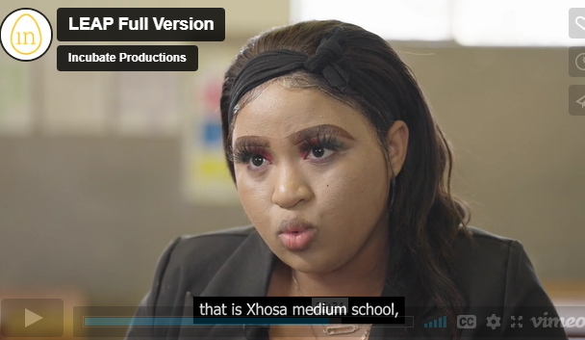
Video of LEAP in Action: Demo of Chatbot and Interview with a Teacher, Siphokazi Mbanga
LEAP Chatbot - Full Video
Click to play video

Slide 13
Linking LEAP to Action Track 4: ‘Digital learning & transformation’
Dr Andile Dube, Education Manager, UNICEF South Africa
Hana Yoshimoto, Chief of Education, UNICEF South Africa

Slide 14
Covid 19 and inequalities
South African Basic Education is a big system
Over 60% are non-fee-paying schools
Continuation of learning is limited for majority of the poor during school closure and rotation
UNICEF’s priority support to
Foundation Phase
Digital learning
Broadcast

Slide 15
Foundation and Intermediate Phases
Most digital learning and broadcast at higher phases of the system need to be developed for learners in primary school especially Foundation Phase
A need to develop for critical phases thus dealing with learning losses

Slide 16
Reimagine Education – Digital Learning
World Class Digital Learning Solutions
Affordable content and data
Devices
Connectivity
Young People’s Engagement
One vision Every Child and Young Person accessing world-class digital learning by 2030 – 3.5 billion children and young people

Slide 17
From Emergency to Recovering – RAPID(ly)

Slide 18
1. Put the most marginalised learners at the centre
Focus on:
Large and multi-grade classes
Rural and under-resourced contexts – mostly quintiles 1–3 (non-fee-paying schools)
Building capacity of parents, caregivers and teachers to support learners

Slide 19
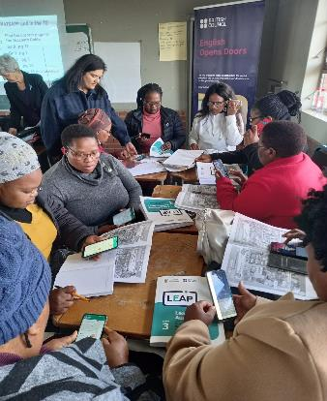
2. Provide world-class digital content
Works with DBE to create quality digital language and literacy content for Grades R–4 in EFAL
Capacity-building
Provides parents, caregivers and teachers with a successful introduction to digital resources and increase their confidence in using educational materials with learners, including training, advocacy ICT troubleshooting, messaging and wraparound support
Builds capacity of parents, caregivers and teachers (particularly those in disadvantaged or remote areas) to access and use digital resources to provide support to children

Slide 20
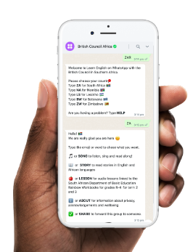
3. Ensure access – develop free, high-quality digital content & platforms
Provides materials free via the WhatsApp Chatbot, clickable PDFs and WhatsApp data bundles
Constantly keeps abreast of technological advances, e.g. relationships with mobile phone providers and Meta (Facebook)
Sets up and manages digital delivery mechanisms (e.g. WhatsApp, TV) that are accessible and user-friendly to South African parents, caregivers and teachers (particularly those in disadvantaged or remote areas)
Aligns to curriculum and language e.g. Foundation Phase – African Languages

Slide 21
4. Facilitate pedagogical innovation and MERL
Embeds Monitoring, Evaluation, Research and Learning (MERL), in collaboration with education departments/ministries, to inform project design and delivery
Teachers as levers – capacity-building of teachers and subject advisers face-to-face and online in 8 provinces of SA

Slide 22
Scaling LEAP in South Africa & Sub-Saharan Africa
Caroline Grant, Director of English Programmes: Sub-Saharan Africa, British Council

Slide 23
Scaling LEAP in Sub-Saharan Africa
Country | How | Target numbers – teachers, parents & caregivers
South Africa | Online training of teachers; embed M+E with DBE, DBE TV and YouTube | 50,000 by 2024
Botswana | Re-engagement with MoE and light online support | 5,000 by 2023
Lesotho | Re-engagement with MoE and light online support | 5,000 by 2023
Namibia | Re-engagement with MoE and light online support | 5,000 by 2023
Zimbabwe | Online training of teachers & embedding M+E | 50,000 by 2024
Rwanda | Curriculum-aligned P1-P3 English language resources from national Building Learning Foundations programme on chatbot | Year 1: 3000 P1-P3 teachers across Rwanda (10% of all P1-P3 teachers)
Senegal | Curriculum-specific resources for secondary teachers (all skills) - focus on speaking accessed on the chatbot. | 1000 secondary teachers per year from a total number of 6,800
Notes:
Work with DBE and UNICEF to find more ways of engaging more teachers, parents/caregivers and learners to use the LEAP TV resource.

Slide 24
LEAP scale-up strategies
Expand teacher development and support by:
Sharing teaching practices as part of CPD
Utilising existing platforms for sharing teaching resources and learning activities
Forming online and offline PLCs
Increase access and visibility of LEAP by:
Partnering with e.g. Telcos, MoEs for investment and zero-rated data access
Increasing online and hybrid training options
Conducting awareness-raising campaigns through mainstream and social media
Extend scope and relevance of materials by:
Extending LEAP to other African countries
Adapting and developing content for contextual relevance
Extending to upper primary and secondary grades
Deepening MERL Collaboration with MoEs and research institutes
Notes:
Better utilise existing partner platforms (DBE, UNICEF, British Council)

Slide 25
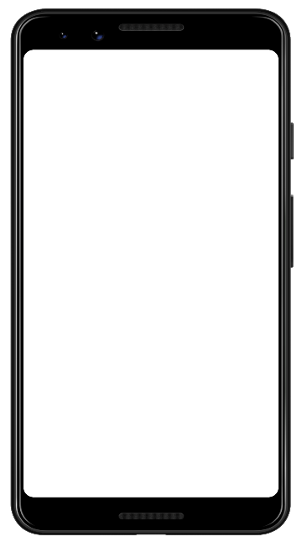
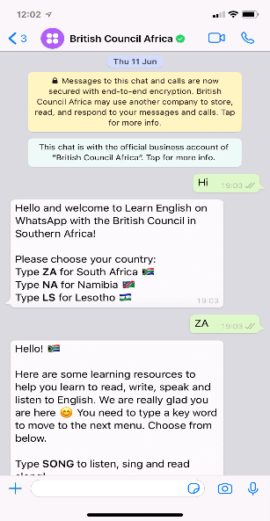
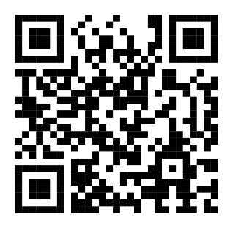
Join LEAP on WhatsApp
Send “Hi” to +27 60 078 93 09
Scan the QR code and say “Hi”
View on YouTube

Slide 26
Questions
Notes:
What would the panel say are the most important factors in helping teachers to embrace and use technology, which they may be unfamiliar with, so that they in turn can help their students to progress with their learning?
Which of these successes give you most hope as we look at the daunting task of achieving Sustainable Development Goal 4 by 2030, only 8 years from now?
How does this digital solution support those who are digitally disadvantaged / inequality? - reframe to talk more broadly so Minster could answer
Question about primary / early reading

Slide 27
Thank you Contacts: caroline.grant@britishcouncil.org joanne.newton@britishcouncil.org.za

